Slide 1



Understanding and Teaching
e-future Teacher Training Workshops
For Better English Education

Slide 2

Let’s Warm Up

Slide 3
PINK
GREEN
GREEN
YELLOW
YELLOW
PURPLE
PURPLE
RED
RED
PINK
BLUE
BLUE

Slide 4
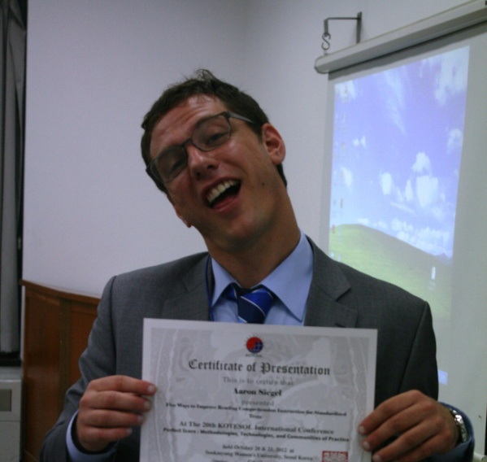

GET TO KNOW YOUR PRESENTER
AARON
HOMETOWN
TEACHING
BEFORE
BIGGEST FEAR
1. Where is Aaron from? BONUS POINTS if you can be more specific.

Slide 5





Slide 6


Slide 7

GET TO KNOW YOUR PRESENTER
AARON
HOMETOWN
TEACHING
BEFORE
BIGGEST FEAR
1. Where is Aaron from? BONUS POINTS if you can be more specific.
2. What is my favorite part of teaching?

Slide 8





Slide 9
GET TO KNOW YOUR PRESENTER
AARON
HOMETOWN
TEACHING
BEFORE
BIGGEST FEAR
1. Where is Aaron from? BONUS POINTS if you can be more specific.
2. What is my favorite part of teaching?
3. What did Aaron do before moving to South Korea?
4. What is my biggest fear in life?

Slide 10








Slide 11
GET TO KNOW YOUR PRESENTER
AARON
HOMETOWN
TEAHCING
BEFORE
BIGGEST FEAR
1. Where is Aaron from? BONUS POINTS if you can be more specific.
2. What is my favorite part of teaching?
3. What did Aaron do before moving to South Korea?
4. What is my biggest fear in life?

Slide 12


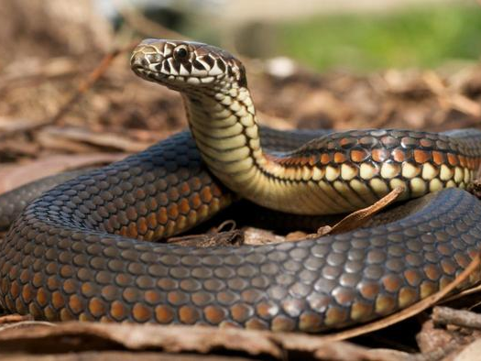


Slide 13

Meet & Greet
Ask and Answer
Name
Teaching experience
Hardest class
Why you teach English
Something extra

Slide 14
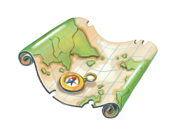
Program
What’s Covered
Introduction to Phonics
Planning Great Lessons
Teaching Techniques and Activities

Slide 15
Part 1
What should students learn?

Slide 16
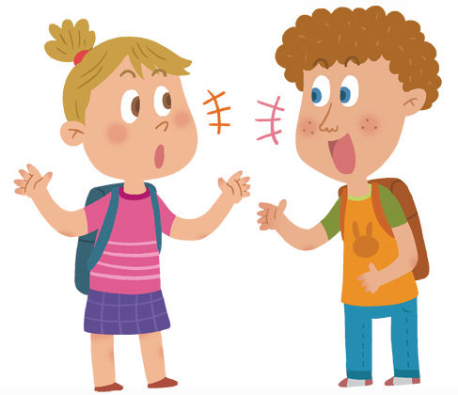
Phonics
Ask and Answer
What is phonics?
Do you teach phonics?
What is difficult about teaching phonics?
What is easy about teaching phonics?

Slide 17
Phonics
Phonics is a skill to help students decode words. It helps students read.
Vol. | Target | Example
1 | The Alphabet | Aa, Bb, Cc
2 | Short vowels | Cat, jet, mit
3 | Long Vowels | Cake, pine, rose
4 | Consonant Blends | Break, slide, thin
5 | Vowel Blend | Green, nail, corn

Slide 18



F
A
N
FAN
참나
ㅊ
ㅏ
ㅁ
ㄴ
ㅏ
???

Slide 19
Phonics
Sight Words
Sight words are phonetically irregular words (you cannot use phonics to read them).
Students must learn sight words
Sight words are very frequent. You learn to read them automatically
Examples: a, an, the, could, did, from, at

Slide 20
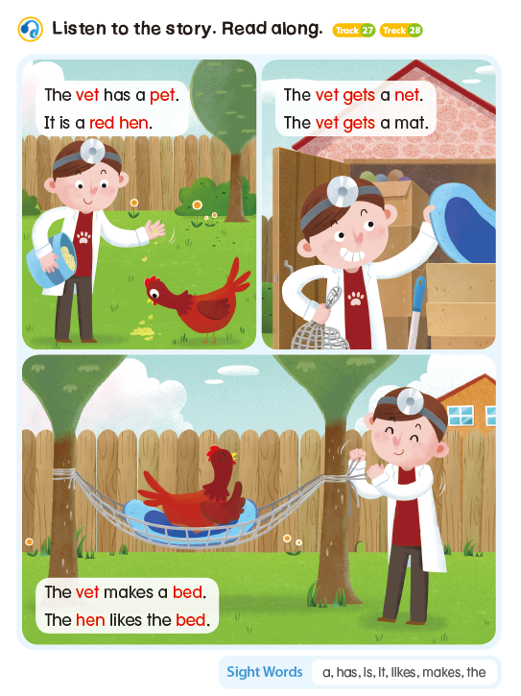


Slide 21
Phonics
What should students learn?
Decoding skills (how to put sounds together)
Sight words (see list in back of book)
Basic vocabulary
Basic classroom language

Slide 22
Phonics
Why should students learn phonics?
Phonics is an essential foundation skill
Phonics especially helps with reading
EFL students can get a lot of input through reading

Slide 23
Part 2
Creating Successful Lessons
(Lesson Planning)

Slide 24

Lesson Planning
Ask and Answer
How much time do you spend planning your lessons?
How do you plan your lessons?
Do you have any challenges?

Slide 25
Lesson Planning
Put the lesson stages in the best order
Wrap-up / Homework
Practice new sounds / words
Warm-up / Review last lesson
Teacher reflects on the day’s lesson
Introduce new sounds / words
Productive game

Slide 26
Lesson Planning
Lesson Stages
Warm-up / Review last lesson
Introduce new sounds / words
Practice new sounds / words
Productive game
Wrap-up / Homework
Teacher reflects on the day’s lesson

Slide 27
Lesson Planning
Lesson Planning Top Tips
Identify specific measurable goals
Break lesson into chunks
Plan different types of interaction
Include at least one fun activity
Reflect on your lesson after class

Slide 28
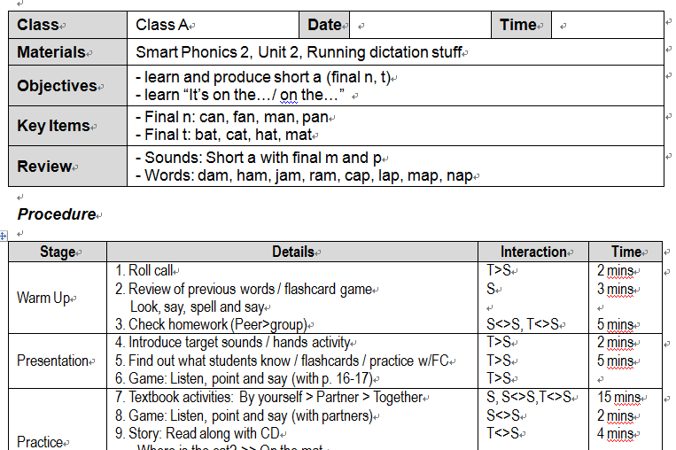
Components

Slide 29
Questions?
Do you have…
Comments
Questions
Concerns?

Slide 30
Part 3
Teaching Techniques

Slide 31
Teaching
General Techniques
Understand your objectives
Let your students do the work
Know when to be quiet
Have meaningful communication with your students (English is useful)

Slide 32

Teaching
Ask and Answer
How do you start class?
Warm-Up Activities
Short, easy, and fun
Lower stress
Includes all students
Reviews (nothing new)

Slide 33
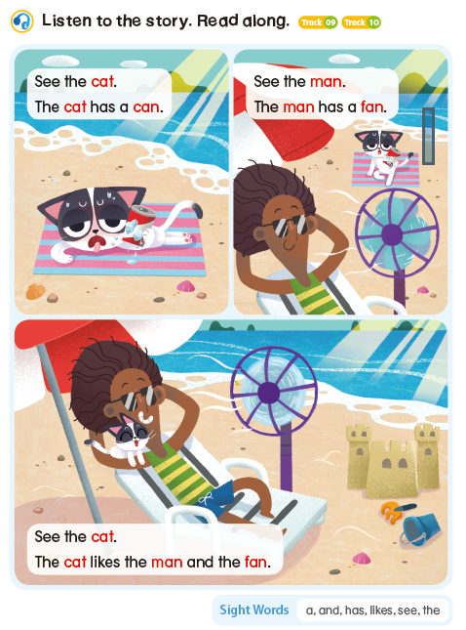


Slide 34
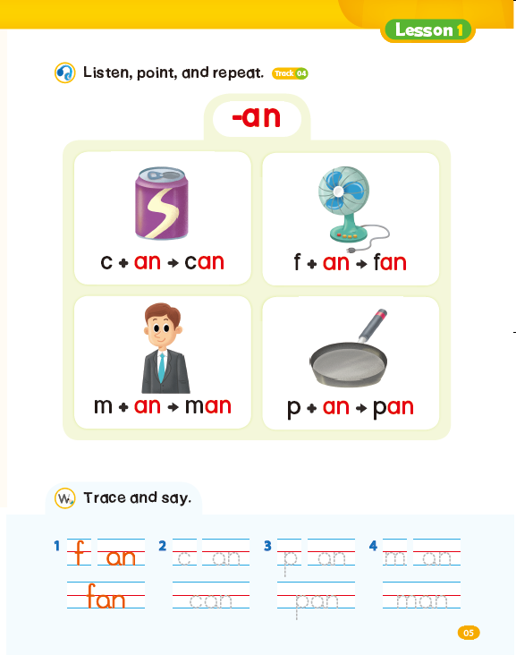
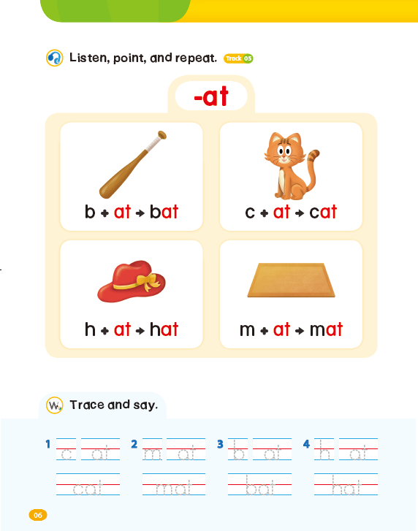
For Better English Education

Slide 35


Slide 36



Slide 37
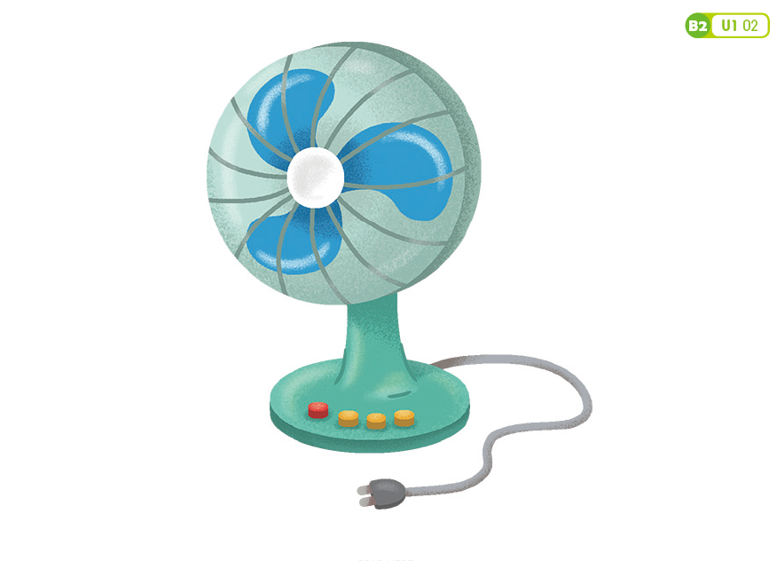

Slide 38


Slide 39


Slide 40
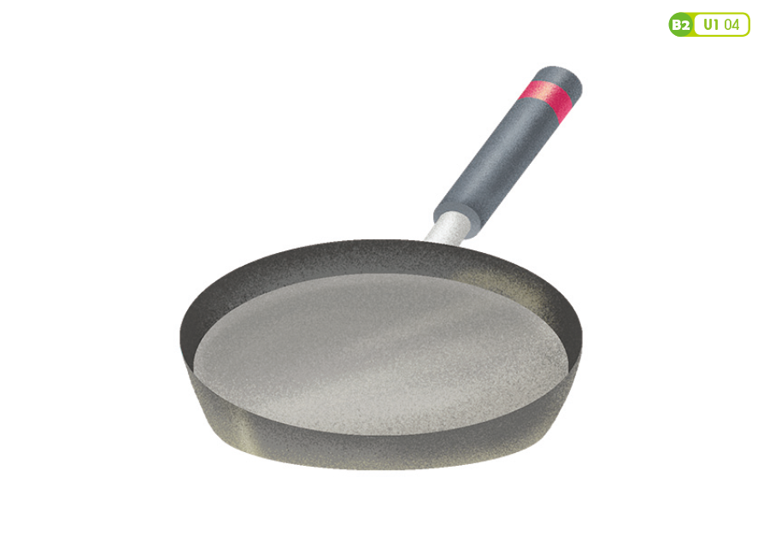

Slide 41
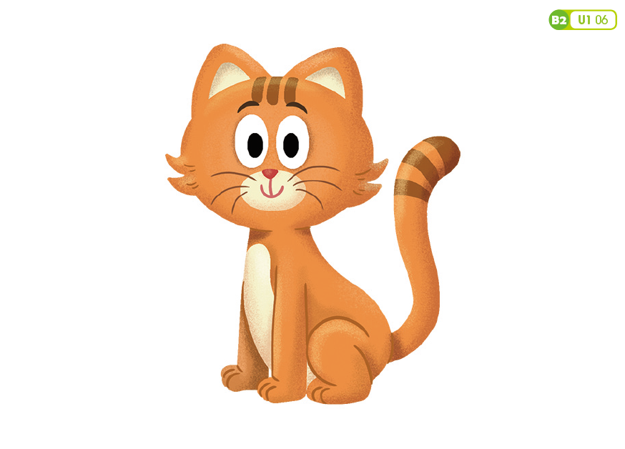

Slide 42


Slide 43
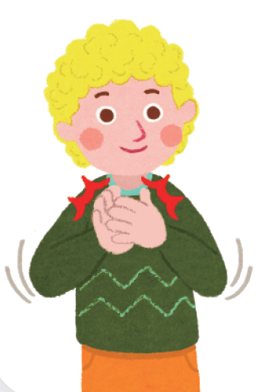
Teaching
New Targets
Use the book/CD
Use the ebook

Slide 44
Teaching
Using the Textbook
Try it by yourself
Check with a partner
Check together
*Use textbook for games

Slide 45

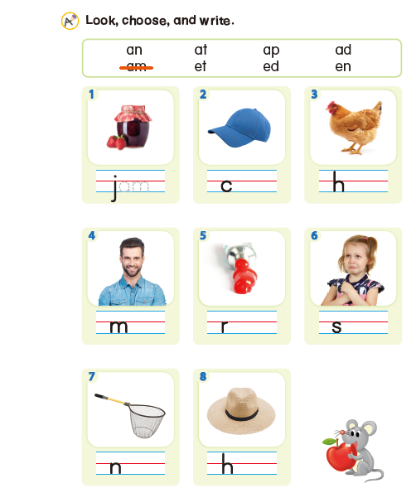

Slide 46

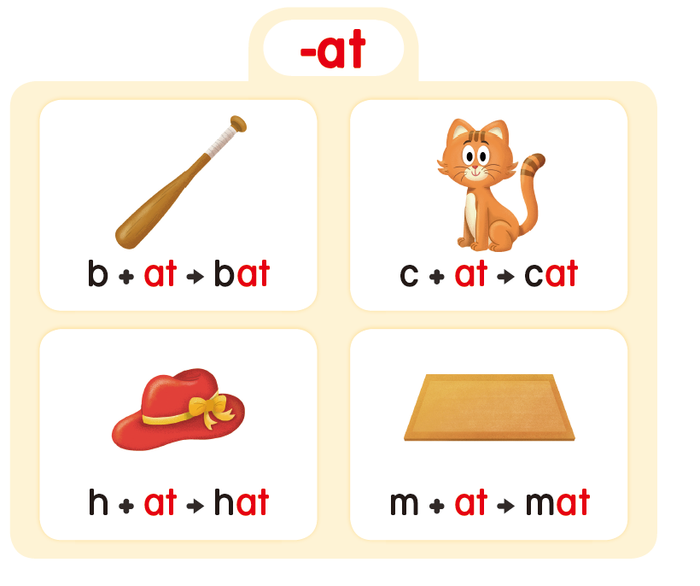

Slide 47
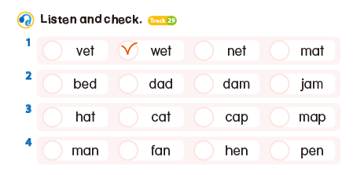

Slide 48





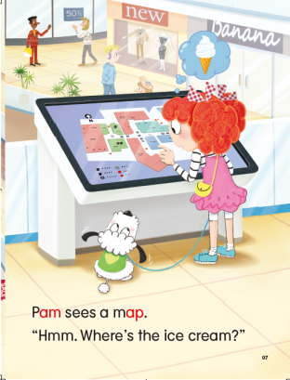
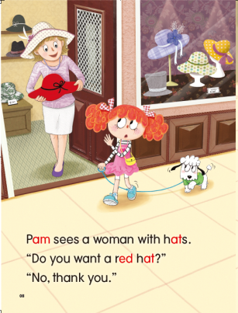
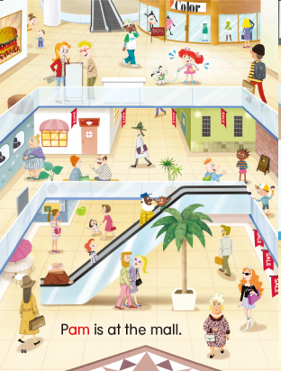

Slide 49
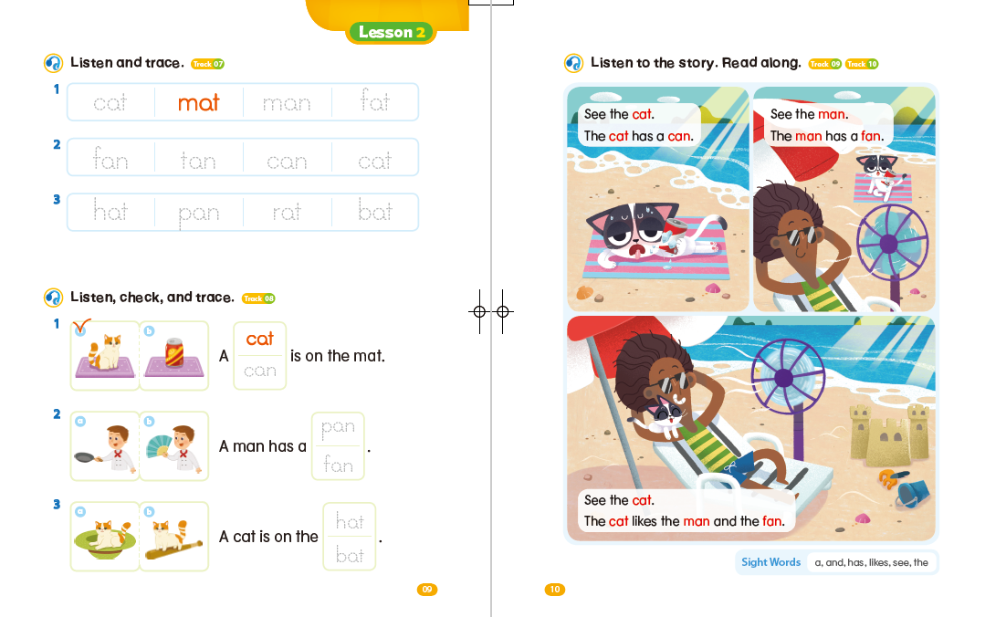

Slide 50
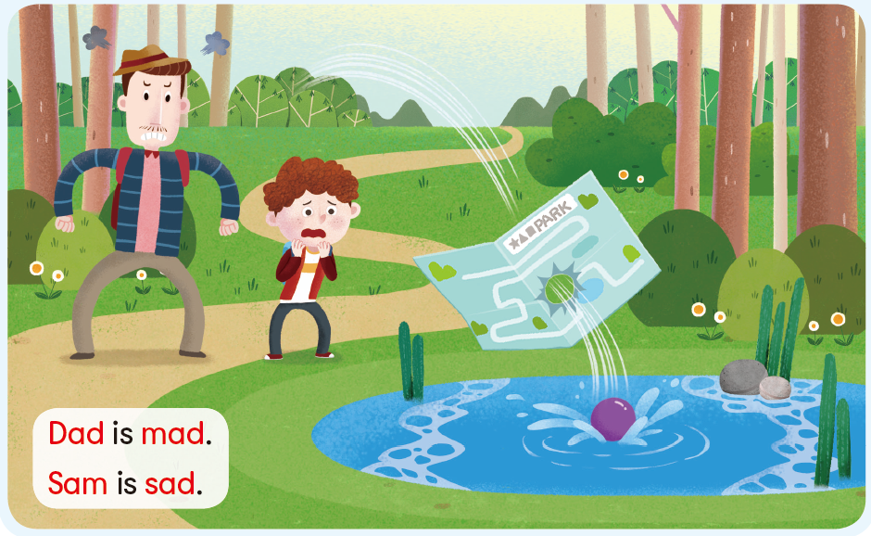

Slide 51
Teaching
New Targets
Use the book/CD
Use the ebook
Use the flashcards

Slide 52
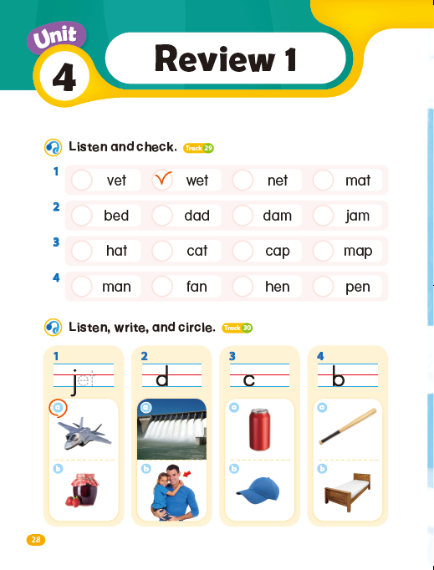


Slide 53


Slide 58


Slide 59


Slide 60


Slide 61


Slide 62
Teaching
USE
VOICE

Slide 63


Slide 64


Slide 65






Slide 66
Teaching
New Targets
Use the book/CD
Use the ebook
Use the flashcards
Use the board

Slide 67
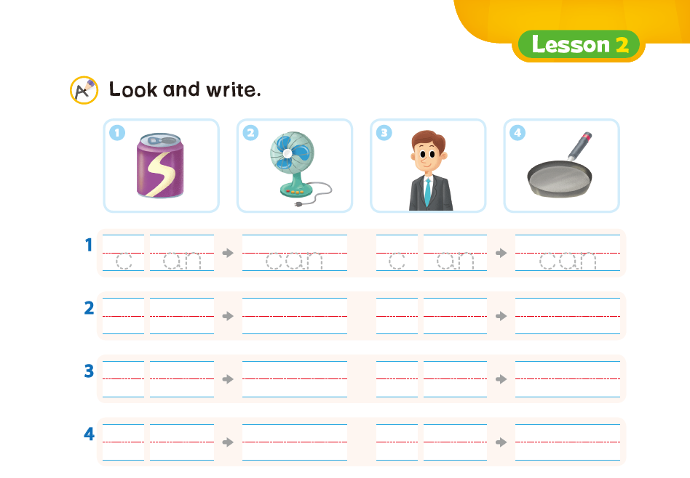
For Better English Education

Slide 68








Slide 74
Teaching
New Targets
Use the book/CD
Use the ebook
Use the flashcards
Use the board
Finger modeling

Slide 76
Teaching
New Targets
Use the book/CD
Use the ebook
Use the flashcards
Use the board
Finger modeling
Use TPR / Others?

Slide 77

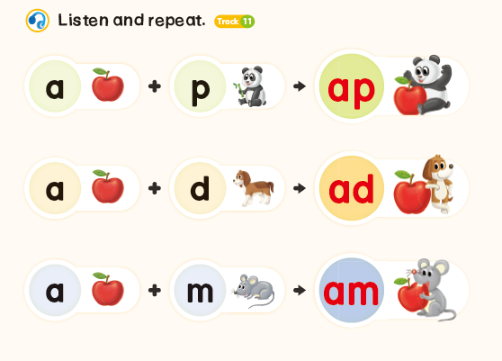


Phonics Kung Fu

Slide 78
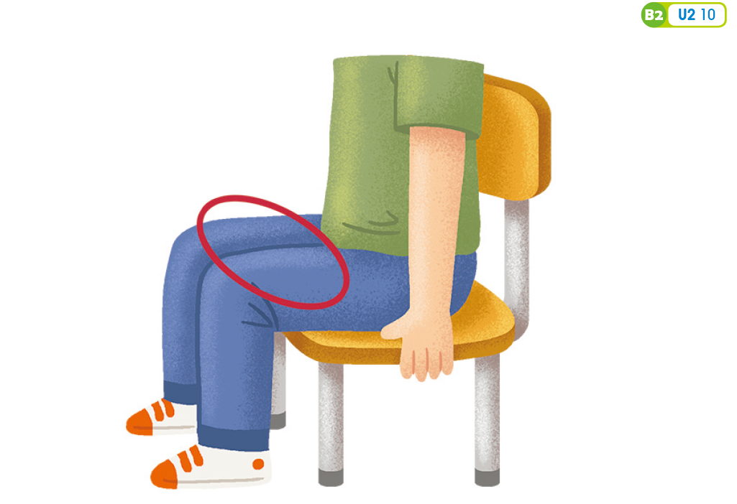

Slide 79


Slide 80
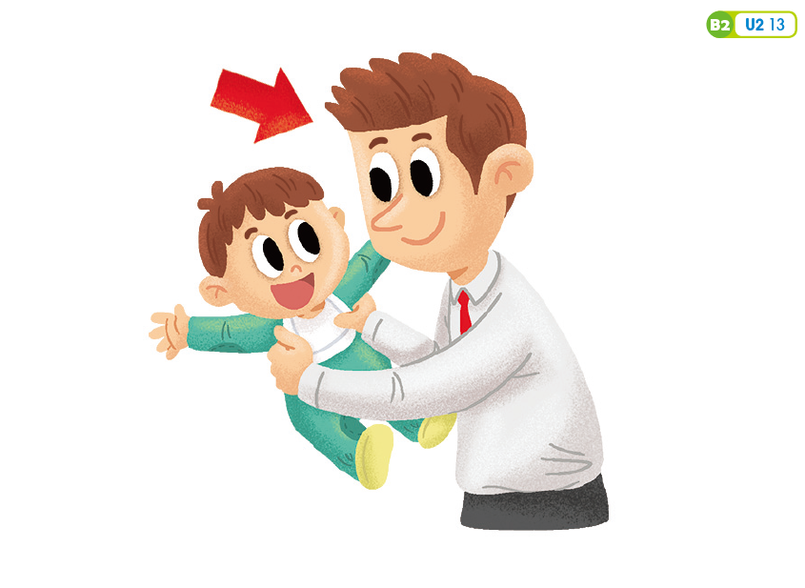

Slide 81


Slide 82


Slide 83


Slide 84


Slide 85


Slide 86


Slide 87


Slide 88


Slide 89


Slide 90
Teaching
Assessing Learners
Understand lesson objectives
Choose an assessment method: formal or informal
Carry out assessment
Make notes / plan to improve

Slide 91
Teaching
Assessment Options
Flash card game (High Noon)
Worksheet / Portfolio
Game
Unit quiz (paper and pencil)
Listening quiz (listen and write)

Slide 92


Slide 93
Teaching
Assessment Options
Flash card game (High Noon)
Worksheet / Portfolio
Game
Unit quiz (paper and pencil)
Listening quiz (listen and write)

Slide 94
Teaching
-at
-ap
-an
-am
-at
-ap
-an
-am
1
5
B
P
2
6
3
7
8
4

Slide 95

Questions?
Do you have…
Comments
Questions
Concerns?

Slide 96

Contact
Contact Us
Don’t hesitate to contact us for more information.
Aaron Siegel: e-future
aaron@eltkorea.com
www.efuture-elt.com
Great!

